Slide 1

Subscribers Galore: Exploring The World's Top YouTube Channels
Presented by
KAVIYA S 611220104067
NISHA C 611220104097
PRIYADHARSHINI K 611220104111
REKHA K 611220104114
UNDER THE GUIDANCE OF
Mr. J .MURUGESAN M.E.,
ASSISTANT PROFESSOR,
DEPARTMENT OF INFORMATION TECHNOLOGY

Slide 2
INTRODUCTION
Subscribers Galore" is an in-depth research project that explores the world's top YouTube channels. It analyzes content, audience engagement, monetization strategies, publishing schedules, subscriber demographics, and aims to gather insights from creators. Through case studies and comparisons, the project identifies trends and principles for YouTube success. It also keeps an eye on emerging channels and provides predictions for YouTube's future. This project offers invaluable insights to content creators and enthusiasts interested in the evolving YouTube landscape

Slide 3
ABSTRACT
Subscribers Galore" is a comprehensive project examining the world's top YouTube channels. It investigates content, audience engagement, monetization strategies, and subscriber demographics. Through case studies, it identifies trends and principles for success.
This project also monitors emerging channels, offering predictions for YouTube's future. It provides valuable insights for content creators and enthusiasts interested in YouTube's evolving landscape.

Slide 4
LITERATURE SURVEY
PAPER-I
TITLE: Customized Criteria-Based Trending Analysis for the YouTube Platform
AUTHOR: Khin Than Nyunt
In a tech-driven world, YouTube's popularity as a career choice is soaring in the United States. YouTube Trending Analysis, using Pearson's Correlation Method, helps aspiring creators choose trending career paths.

Slide 5
LITERATURE SURVEY
PAPER-II
TITLE: Youtube Data Collection Through Parallel Processing
AUTHOR: Joseph Kready, Shishila Awung Shimray, Muhammad Nihal Hussain, Nitin Agarwal
YouTube's Data API is a valuable resource for studying human behavior. We've introduced a Python-based parallel processing method, reducing data collection time by 400% for social studies research.

Slide 6
LITERATURE SURVEY
PAPER-III
TITLE: Information and Process Management of Successful YouTube Channels
AUTHOR: Antonin Pavlicek, Martin Potancok, Radim Cermak
YouTube provides vast content creation opportunities. This article analyzes data from Social Blade, aiming to find correlations between categories, upload frequency, popularity metrics, and view counts. Exciting findings include relationships between subscriber count and annual uploads across various channel types.

Slide 7
LITERATURE SURVEY
PAPER-IV
TITLE : An Open-Source Website And Youtube Channel For Embedded Systems Education
AUTHOR: Pramod Abichandani, Deepan Lobo, Chris Berry, Vaishali Parikh, William Fligor, William McIntyre
MATLABArduino.org and its YouTube channel offer free, high-quality content showcasing MATLAB and Arduino applications in embedded systems education. The paper covers video content, viewership patterns, comments, and challenges in online education.

Slide 8
DRAWBACKS IN EXISTING SYSTEM
Changing Landscape.
Incomplete Data.
Overgeneralization.
Copyright and Fair Use
Ethical Concerns.

Slide 9
PROPOSED SOLUTION
Fast Analysis of Subscribers data using IBM Cognos.
Fast Recovery of Data.
Accurate Result of Data
Fast prediction

Slide 10
ADVANTAGES
Insightful Content - The project provides valuable insights into the strategies and dynamics behind the success of top YouTube channels, serving as an educational resource for content creators and enthusiasts.
Inspiration - It can inspire new content creators by showcasing the journeys and strategies of successful YouTube channels, encouraging creativity and innovation.
Educational Value - It can be used as a resource in educational institutions to teach about the digital media landscape and online marketing.

Slide 11
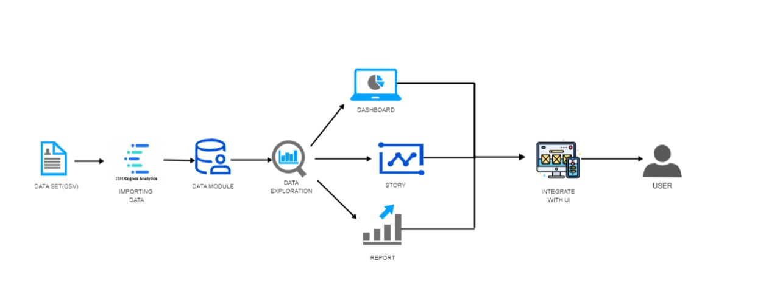
WORKFLOW DIAGRAM

Slide 12
SYSTEM SPECIFICATION
HARDWARE USED:
Processor : Intel Core i5-4200U CPU
RAM : 4 GB
Hard Disk : 1 TB
SOFTWARE USED:
Operating System : Windows
Language : Bootstrap
Implementation-
Tool : IBM Cognos Analytics

Slide 13
SYSTEM SPECIFICATION
TOOL REQUIREMENTS
Operating System : Windows 10 / 8.1 / 8
Disk Space : 256 MB
Processor : Intel atom processor
Version : 3.6.2
LANGUAGES DESCRIPTION
HTML
CSS
BOOTSTRAP

Slide 14
MODULE DESCRIPTION
1. DATA PREPROCESSING: Data preprocessing is the first machine learning step in which we transform raw data
obtained from various sources into a usable format to implement accurate analysis methods.
2. DASHBOARD:A dashboard in data analytics is a visual
representation of data that provides an overview of key metrics, trends, and insights. It typically consists of various visual components such as charts, graphs, tables, and widgets, which are designed to convey information quickly and effectively

Slide 15
MODULE DESCRIPTION
3. REPORT: The report emphasizes the significance of data analytics in unlocking valuable insights and emphasizes the potential for continued exploration and discovery in the field of data analytics.
4. STORY : In data analytics, the story serves as a powerful tool for communication and persuasion. It helps bridge the gap between technical analysis and decision-makers by presenting insights in a narrative format that resonates with the audience.

Slide 16
MODULE DESCRIPTION
5. WEB INTEGRATION : All the visualized data is delivered to the user through a web application which is coded in HTML. For this feature, the flask is used to integrate the web pages. It runs by Python to interconnect all the project HTML file pages. It gives smooth transition of pages on web application.

Slide 17
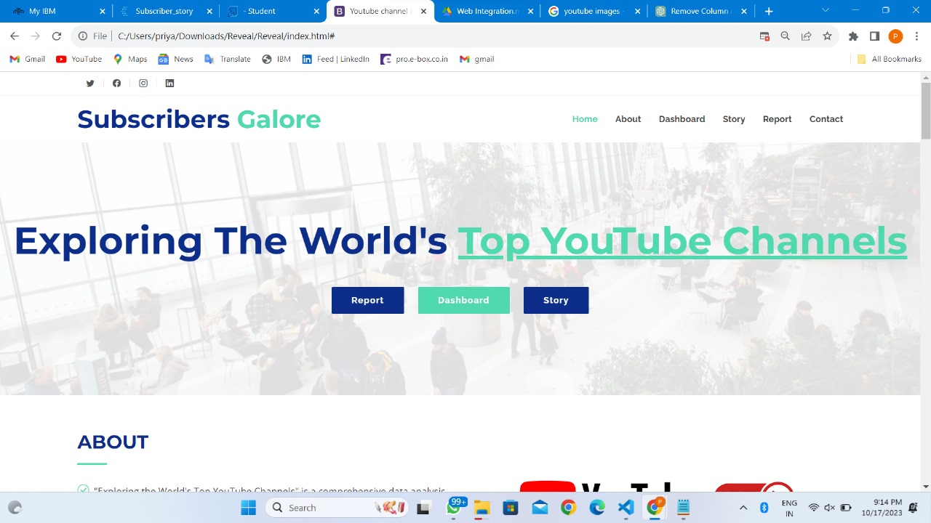
RESULT AND DISCUSSION

Slide 18
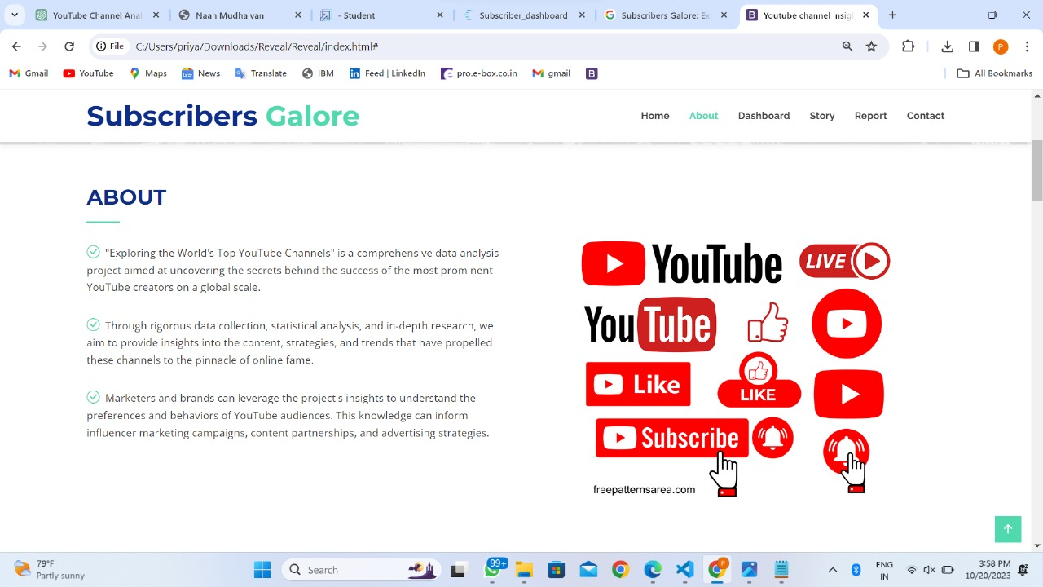
RESULT AND DISCUSSION

Slide 19
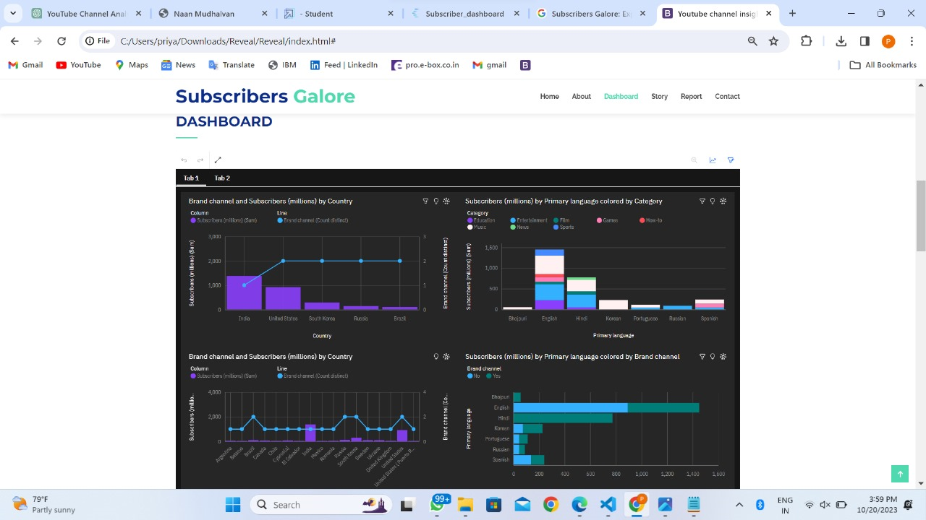
RESULT AND DISCUSSION

Slide 20
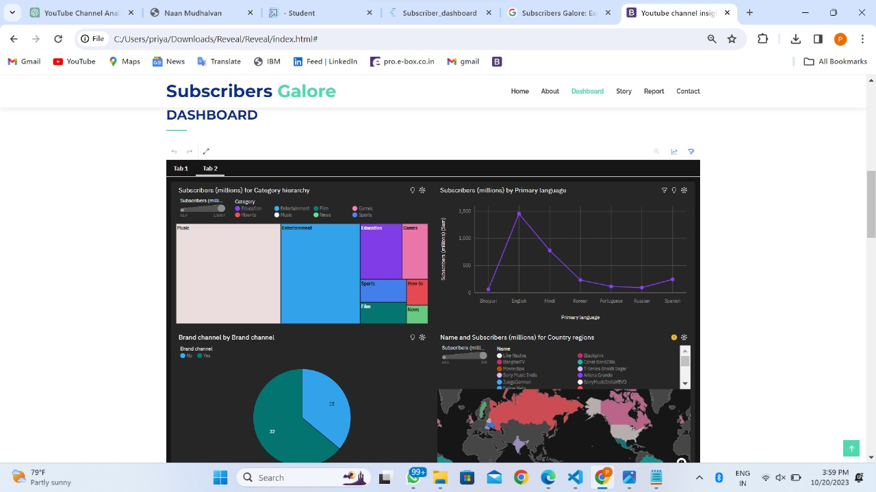
RESULT AND DISCUSSION

Slide 21
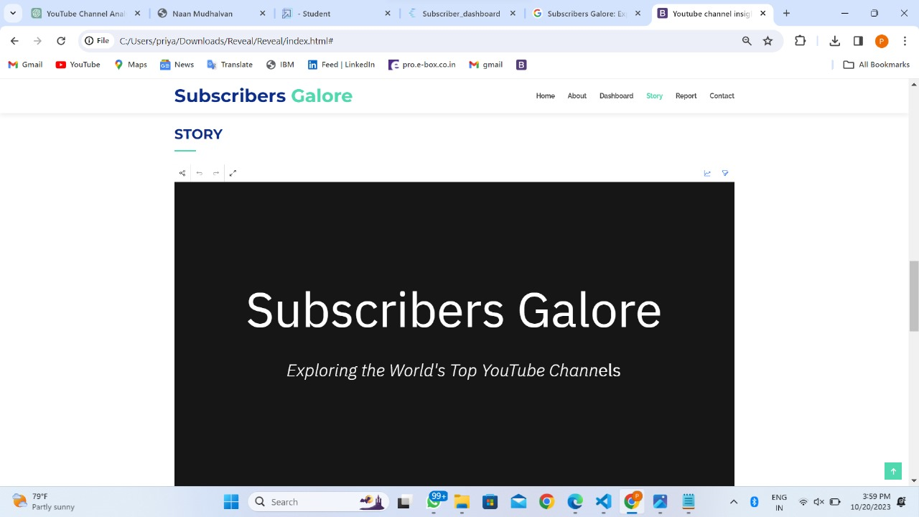
RESULT AND DISCUSSION

Slide 22
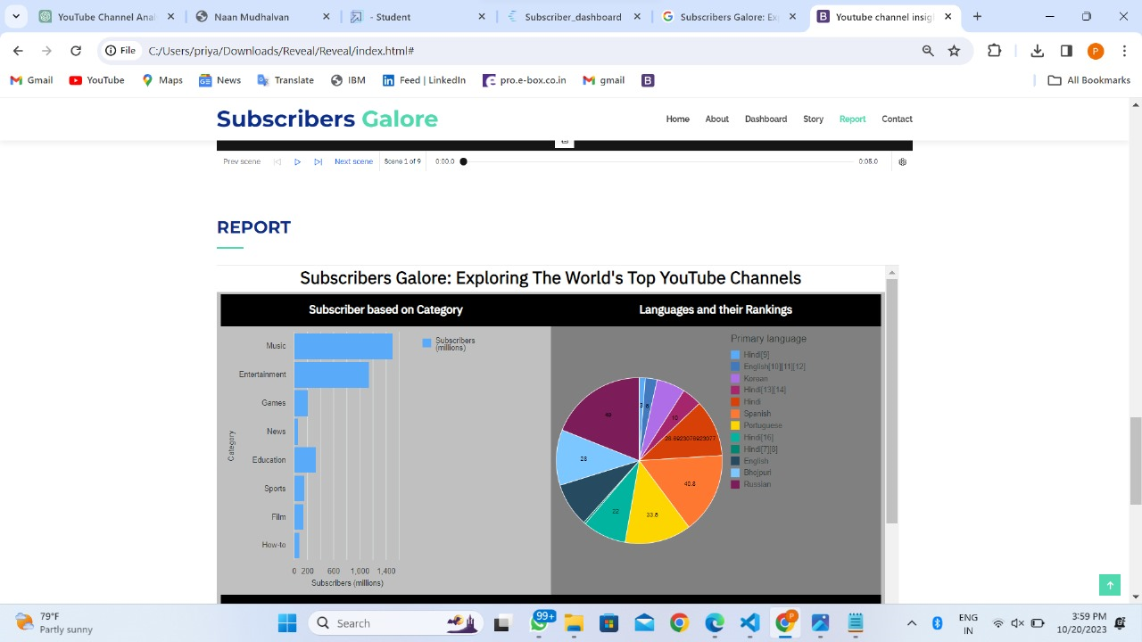
RESULT AND DISCUSSION

Slide 23
CONCLUSION
"In conclusion, "Subscribers Galore: Exploring The World's Top YouTube Channels" is a purpose-driven initiative that enriches the digital landscape, offering knowledge and inspiration to the online community. This documentary-style exploration delves into the diverse realms of YouTube, providing insights into top channels and their creators, ultimately revealing the secrets to their success.
Furthermore, "Subscribers Galore" fosters unity among YouTube enthusiasts, inspiring creativity and encouraging new content creators to embark on their unique journeys."

Slide 24
FUTURE SCOPE
The future of "Subscribers Galore: Exploring The World's Top YouTube Channels" holds promise as digital content platforms, especially YouTube, continue to evolve. It will remain relevant by adapting to new technologies and content formats, offering valuable insights to creators and marketers. Expanding to cover emerging channels and other platforms will provide a comprehensive view of the digital media landscape, ensuring its continued relevance in the dynamic online content world.

Slide 25
REFERENCES
[1.] Nyunt, K. T., & Khin, N. T. W. (2023). "Customized Criteria-Based Trending Analysis for YouTube Platform”.
[2.] Abichandani, P., Lobo, D., Berry, C., Parikh, V., Fligor, W., & McIntyre, W. (2021). "An Open-Source Website and YouTube Channel for Embedded Systems Education.”
[3.] Kready, J., Shimray, S. A., Hussain, M. N., & Agarwal, N. (2020). "YouTube Data Collection Using Parallel Processing”.
.
[4.] Pavlicek, A., Potancok, M., & Čermák, R. (2020). "Information and Process Management of Successful YouTube Channels."

Slide 26
THANK YOU

